Slide 1
DCAE Analysis

Slide 2
Topics
Overview
DCAE Role in Close loop
DCAE Architecture (Design Time)
DCAE Onboarding, Design and distribution Flow
Onboarding
Design
Distribution
DCAE Architecture (Run time)
DCAE Runtime Flow
APIs
Microservice configuration Policy
DCAE Micro services Services
Collectors
Analytics
Event Processor
Prepare DCAE dev env. (Later)
Steps to add a microservice to DCAE (later)
DCAE in use case.
vCPE
ccVPN

Slide 3
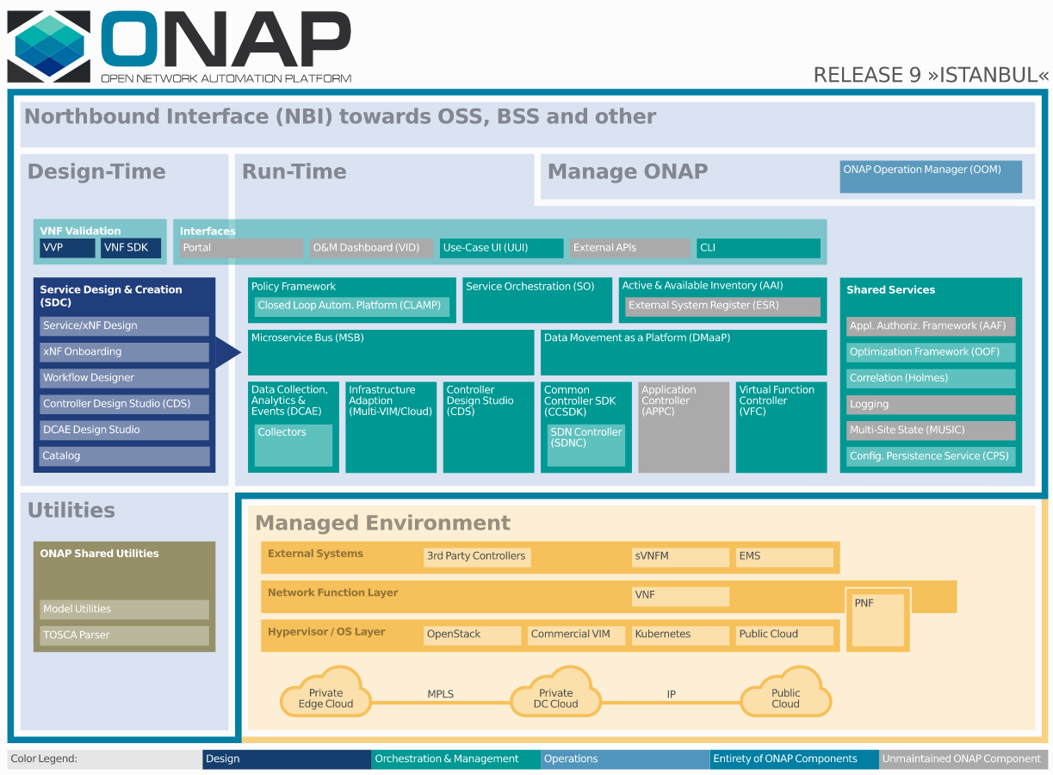
DCAE (Birds Eye View)
Data Collection Analytics and Events (DCAE) is the primary data collection and analysis system of ONAP. DCAE has two parts in ONAP, design part and Runtime.
The DCAE Design platform aims to provide a common catalog of available for DCAE Service components, enabling designers to select required components to construct and deploy composite flows into DCAE Runtime platform.
The Runtime closed control loops starts with DCAE.
DCAE collects performance, usage, and configuration data; provides computation of analytics; aids in troubleshooting; and publishes events, data and analytics.
Figure provides a high-level view of the ONAP architecture with its microservices-based platform components. Also Highlights DCAE ‘s positions in ONAP

Slide 4
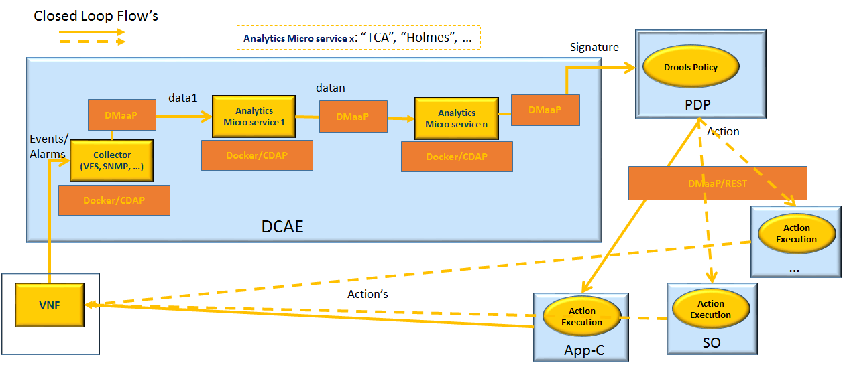
DCAE’s Role in Close Loop
Example Close Loop depiction involving DCAE Components
DCAE collects performance, usage, and configuration data; provides computation of analytics; aids in troubleshooting; and publishes events, data and analytics.
After data collection/verification phase, data are moved through the loop of micro-services like Homes for event detection, Policy for determining actions, and finally, controllers and orchestrators to implement actions.

Slide 5
DCAE DESIGN TIME

Slide 6
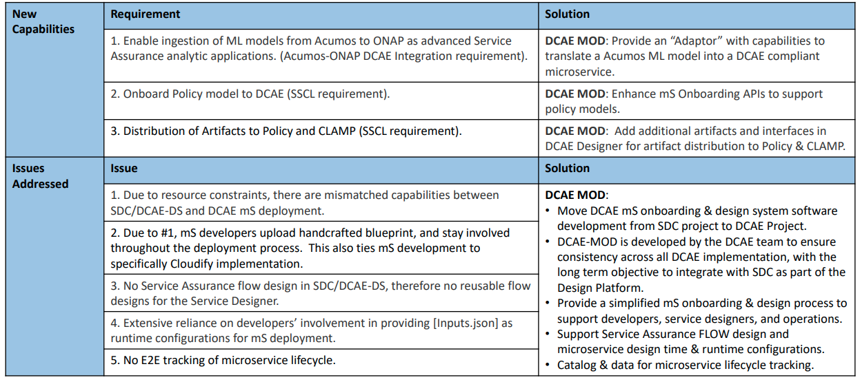
DCAE MOD Introduction
DCAE MOD is composed of a mix of components developed in ONAP and other components taken from the Apache Nifi project and modified for appropriate use. The MOD architecture and design was intended to simplify the onboarding and design experience in ONAP addressing below goals.
DCAE MOD helps in below part of life cycle of DCAE services:
Onboarding
Design and distribution

Slide 7
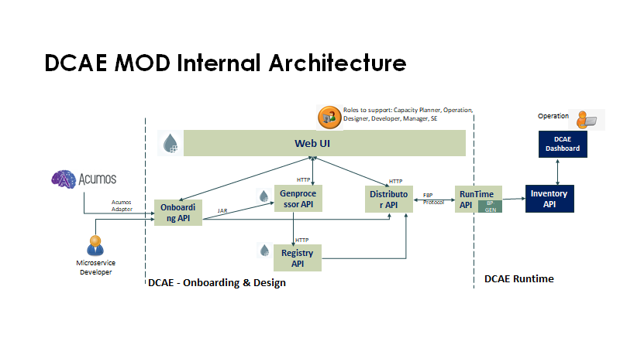
DCAE MOD Architecture
Onboarding API
It is a component developed to onboard models/components/microservices (spec files) into DCAE MOD.
Genprocessor
This project is a tool to experiment with generating a Nifi Processor POJO from a DCAE component spec.
Nifi Web UI
Apache NiFi is a dataflow system based on the concepts of flow-based programming.The NiFi UI provides mechanisms for creating automated dataflows, as well as visualizing, editing, monitoring, and administering those dataflows.
Registry API
This component taken from the Apache Nifi project, is a REST API that provides an interface to a registry with operations for saving, versioning, reading NiFi flows and components.
Distributor API
It is a HTTP API to manage distribution targets for DCAE design. Distribution targets are DCAE runtime environments that have been registered and are enabled to accept flow design changes that are to be orchestrated in that environment.
Runtime API
It is a HTTP API to support runtime environment for DCAE-MOD. It has two major functionalities:
It accepts changes on the flow-graph via fbp protocol
It generates and distributes blueprints based on the change made on the flow-graph

Slide 8
DCAE MOD architecture
Blueprint Generator
This tool allows the user to create a blueprint from a component spec json file. This tool is used by the runtime api.
It also create policy model for configuration policy for DCAE microservices.
Inventory API
DCAE Inventory is a web service that provides the following:
Real-time data on all DCAE services and their components
Comprehensive details on available DCAE service types
DCAE Inventory is a composite API that relies on other APIs to obtain resources on underlying components and uses these resources to compose a DCAE service resource. In addition, DCAE Inventory will store data that is unique to the DCAE service level including:
DCAE service metadata
DCAE service type description and composition details
Relationships between DCAE service and DCAE service types and their respective VNF and VNF types
Think of it as a backend API for the DCAE dashboard.
DCAE Dashboard
The DCAE dashboard provides visibility into running DCAE services for operational purposes. It queries the DCAE Inventory for aggregate details on all the running DCAE services and for getting up-to-date status information on DCAE services and their components.
information on DCAE services and their components.
This tool allows the user to create a blueprint from a component spec json file. This tool is used by the runtime api.

Slide 9
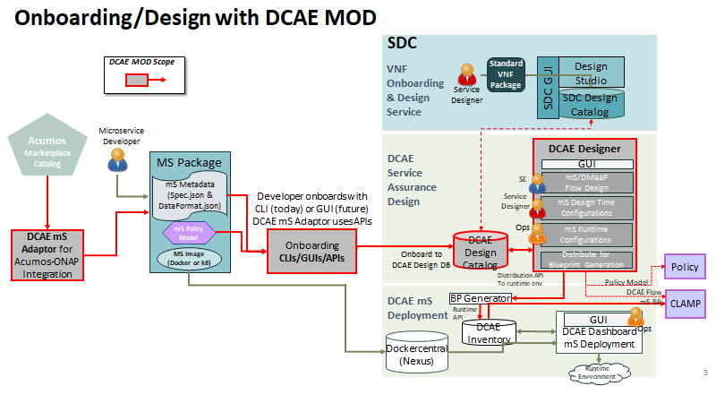
Onboarding/Design/Distribution flow with DCAE MOD
A model/component/microservice can be onboarded by a ms Developer by posting a spec file on the onboarding API. Alternatively, an Acumos model can be onboarded using the Acumos Adapter.
Once successfully onboarded, the genprocessor converts them to jars and onboards them into Nifi i.e DCAE MOD.These artifacts are now available to use from the Modified Nifi Web UI i.e DCAE Designer.
The images goes to image registry, rest goes to DCAE design catalog.
The registry api offers version control and retrieval for flows. The distributor api can be used to set distribution targets.
Once a flow is designed and distributed, it goes to the distributor api which is supposed to post graph changes (in accordance with fbp) to the runtime api.
The runtime api generates and distributes blueprints based on the change made on the flow-graph. These blueprints received by the DCAE inventory can then be viewed and deployed from the DCAE dashboard.
NOTE:
The Red dotted line is for future example
DCAE Design UI can generates policy model and artifacts. Or it can integrate with CLAMP to deploy a flow in close loop.

Slide 10
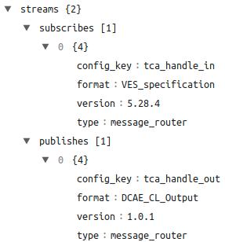
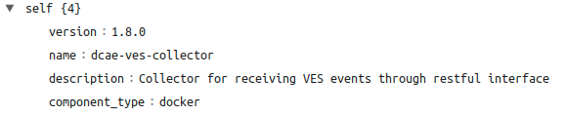
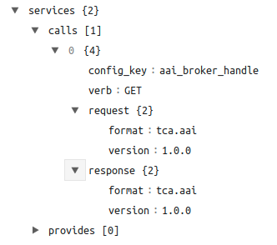
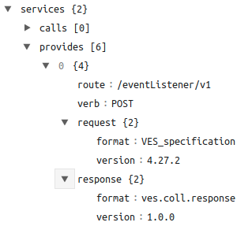
DCAE Onboarding Concepts : Component Spec
Component Spec:
The component specification is a JSON artifact that fully specifies the component, it’s interfaces, and configuration. It’s standardized for CDAP (deprecated) and Docker applications and is validated using a JSON schema.
The component specification fully specifies all the configuration parameters of the component. This is used by the designer and by policy (future) to configure the runtime behavior of the component.
The component specification is used to generate application configuration in a standardized JSON that the platform will make available to the component.
This application configuration JSON will include:
Parameters that have been assigned values from the component specification, policy, and/or the designer
Connection details of downstream components
The component specification is transformed by DCAE tooling (explained later) into TOSCA models (one for the component, and in the future, one for Policy). The TOSCA models then get transformed into Cloudify blueprints.
1. Metadata identifies the component
2. The streams JSON is for specifying data produced for consumption by other components, and the streams expected to subscribe to that is produced by other components.
3.a. The JSON services/calls is for specifying that the component relies on an HTTP(S) service—the component sends that service an HTTP request, and that service responds with an HTTP reply.
3.b: This describes that this component provides a service interface and it is exposed on the /eventListener/v1 HTTP endpoint.
https://docs.onap.org/projects/onap-dcaegen2/en/istanbul/sections/design-components/component-specification/component-type-docker.html

Slide 11
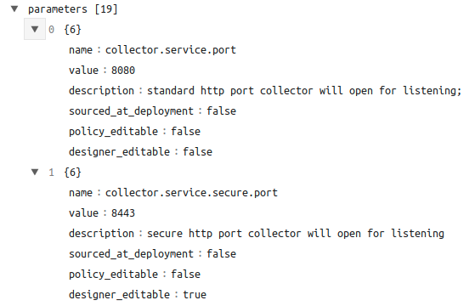
DCAE Onboarding Concepts : Component Spec Continue
Property Name | Type | Description
name | string | Required. The property name that will be used as the key in the generated config
value | any | Required. The default value for the given parameter
description | string | Required. Human-readable text describing the parameter like what its for
type | string | The required data type for the parameter
required | boolean | An optional key that declares a parameter as required (true) or not (false)
constraints | array | The optional list of sequence d constraint clauses for the parameter. See below
entry_schema | string | The optional key that is used to declare the name of the Datatype definition for entries of set types such as the TOSCA ‘list’ or ‘map’. Only 1 level is supported at this time
designer_editable | boolean | An optional key that declares a parameter to be editable by designer (true) or not (false)
sourced_at_deployment | boolean | An optional key that declares a parameter’s value to be assigned at deployment time (true)
policy_editable | boolean | An optional key that declares a parameter to be editable by policy (true) or not (false)
policy_schema | array | The optional list of schema definitions used for policy. See below
4. Prameters is where to specify the component’s application configuration parameters that are not connection information.
Parameter fields
https://docs.onap.org/projects/onap-dcaegen2/en/istanbul/sections/design-components/component-specification/component-type-docker.html

Slide 12
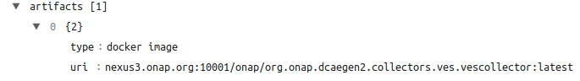
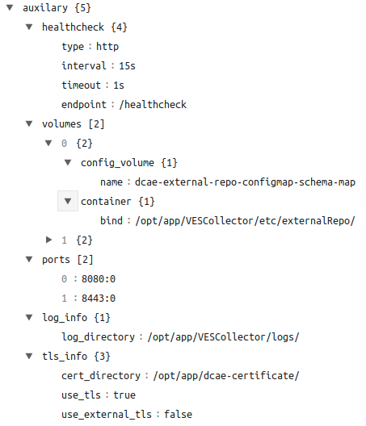
DCAE Onboarding Concepts : Component Spec Continue
5. artifacts contains a list of artifacts associated with this component. For Docker, this is the full path (including the registry) to the Docker image.
Name | Type | Description
healthcheck | JSON object | Required. Health check definition details
ports | JSON array | each array item maps a container port to the host port. See example below.
volumes | JSON array | each array item contains volume definition of either: host path or config map volume.
policy | JSON array | Required. Policy reconfiguration script details
tls_info | JSON object | Optional. Information about usage of tls certificates
5. auxiliary contains Docker specific details like health check, port mapping, volume mapping and policy reconfiguration script details
Auxiliary Table
https://docs.onap.org/projects/onap-dcaegen2/en/istanbul/sections/design-components/component-specification/component-type-docker.html

Slide 13
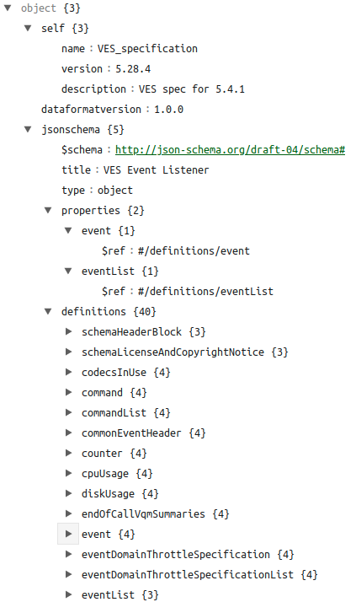
DCAE Onboarding Concepts: Data Format
Data format:
A component’s function could require connecting to other components to fulfill that function. A component could also be providing its function as a service through an interface for other components to use.
The upstream and downstream components must speak the same vocabulary or data format. The output of an one component must match another component’s input. This is necessary for components to function correctly and without errors.
The platform requires data formats to ensure that a component will be run with other compatible components.
Data formats can and should be shared by multiple components.
Note: Currently Data format is not used for any purpose after onboarding process. In future it may be deprecated.
An data format with json schema example

Slide 14
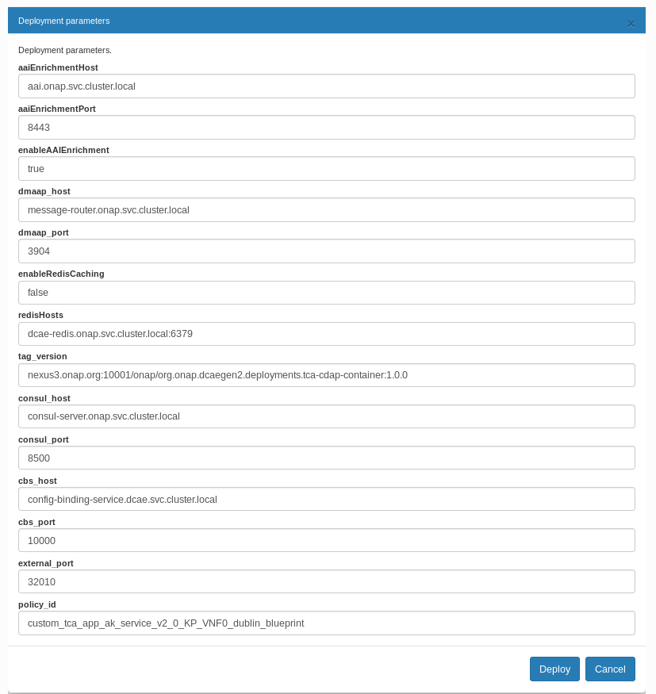
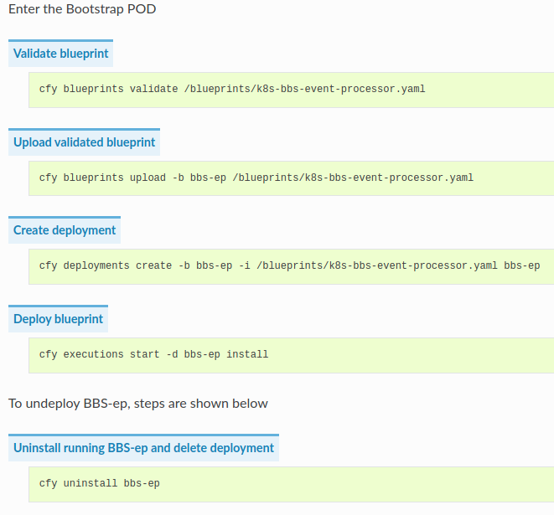
DCAE Onboarding Concepts: Blueprint
Blueprint File: An application in Cloudify is described in a blueprint and its DSL (Domain Specific Language) is based on the TOSCA standard. Blueprint files are written in YAML and describe the logical representation of an application. In a blueprint, you describe the application’s components, how they relate to one another, how they are installed and configured and how they are monitored and maintained.
Blueprint generated by blueprint generator
Example Blueprint file:
https://github.com/onap/dcaegen2-platform-blueprints/blob/master/blueprints/k8s-bbs-event-processor.yaml
Note: In clamp we can modify the input fields of a blue printfile.
Manually install a blueprint file using cloudify.

Slide 15
DCAE Onboarding Concepts: Blueprint Generator
What is Blueprint Generator?
The blueprint generator is java-based tool to take a component spec for a given micro-service and translate that component spec into a cloudify blueprint yaml file that can be used during deployment in DCAE Runtime platform.
Service components to be deployed as stand-alone (i.e not part of DCAE service composition flow) can use the blueprint-generator utility to create deployment yaml. The generated blueprint can be uploaded to inventory and deployed from Dashboard directly.
How to Run the blueprint generator.
$ java -jar blueprint-generator-onap-executable-1.7.3.jar app ONAP -p blueprint_output -i rcc_spec.json -n TestAppBlueprint -d
Options:
-i OR --component-spec: The path of the ONAP Blueprint INPUT JSON SPEC FILE (Required)
-p OR --blueprint-path: The path of the ONAP Blueprint OUTPUT where it will be saved (Required)
-n OR --blueprint-name: The NAME of the ONAP Blueprint OUTPUT that will be created (Optional)
-t OR --imports: The path of the ONAP Blueprint IMPORT FILE (Optional)
-o OR --service-name-override: The Value used to OVERRIDE the SERVICE NAME of the ONAP Blueprint (Optional)
-d OR --dmaap-plugin: The option to create a ONAP Blueprint with DMAAP Plugin (Optional)
Syntax to run from command line:
For Blueprint : java -jar target/<JAR Filename>.jar app ONAP -i componentspec -p OutputBlueprintPath -n Blueprintname -d
For PolicyCreate: java -jar target/<JAR Filename>.jar app ONAP -type policycreate -i componentspec -p OutputPolicyPath
Code: https://github.com/onap/dcaegen2-platform-cli
Doc: https://docs.onap.org/projects/onap-dcaegen2/en/istanbul/sections/design-components/blueprint_generator.html

Slide 16
DCAE Onboarding Flow
1
Defining the data formats if they don’t already exist.A component is a software application that performs a function. It doesn’t run independently; it depends upon other components. The upstream and downstream components must speak the same vocabulary or data format.
Defining the component specification. The component specification is a JSON artifact that fully specifies the component, it’s interfaces, and configuration.
Component Spec for DCAE-VES-Collector : https://git.onap.org/dcaegen2/collectors/ves/tree/dpo/spec/vescollector-componentspec.json
Component Spec for DCAE-TCAgen2 : https://git.onap.org/dcaegen2/collectors/ves/tree/dpo/spec/vescollector-componentspec.json
2
VES 5.28.4 Data Format : https://git.onap.org/dcaegen2/collectors/ves/tree/dpo/data-formats/VES-5.28.4-dataformat.json
VES Collector Response Data Format : https://git.onap.org/dcaegen2/collectors/ves/tree/dpo/data-formats/ves-response.json
TCA CL Data Format : https://git.onap.org/dcaegen2/analytics/tca-gen2/tree/dcae-analytics/dpo/dcaeCLOutput.json
onboard a data format and a component
Each component has a description that tells what it does.
These requests would be of the type-
curl -X POST http://<onboardingapi host>/onboarding/dataformats -H "Content-Type: application/json" -d @<filepath to request>
curl -X POST http://<onboardingapi host>/onboarding/components -H "Content-Type: application/json" -d @<filepath to request>

Slide 17
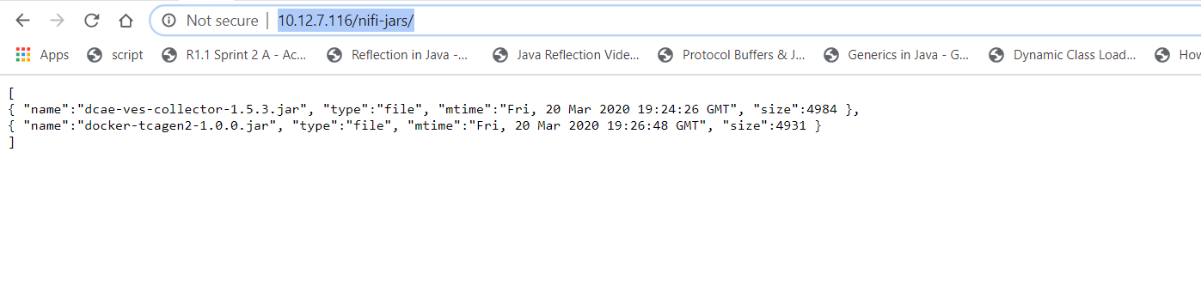
DCAE Onboarding Flow Cont..
3
Verify the resources were created using
curl -X GET http://dcaemod.simpledemo.onap.org/onboarding/dataformats
curl -X GET http://dcaemod.simpledemo.onap.org/onboarding/components
Verify the genprocessor (which polls onboarding periodically to convert component specs to nifi processor), converted the component
Open http://dcaemod.simpledemo.onap.org/nifi-jars/ in a browser.
These jars should now be available for you to use in the nifi UI as processors.
4

Slide 18
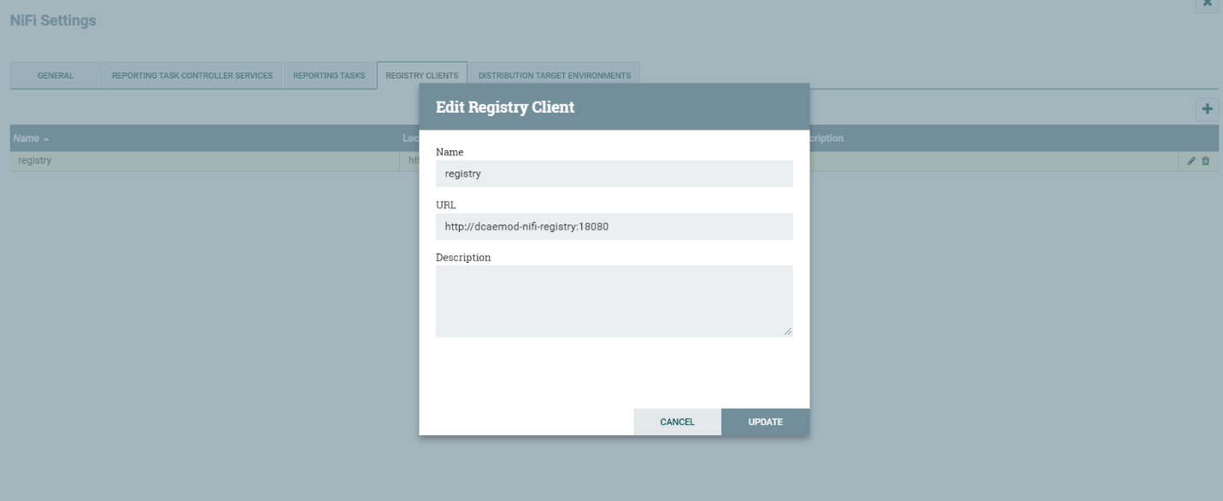
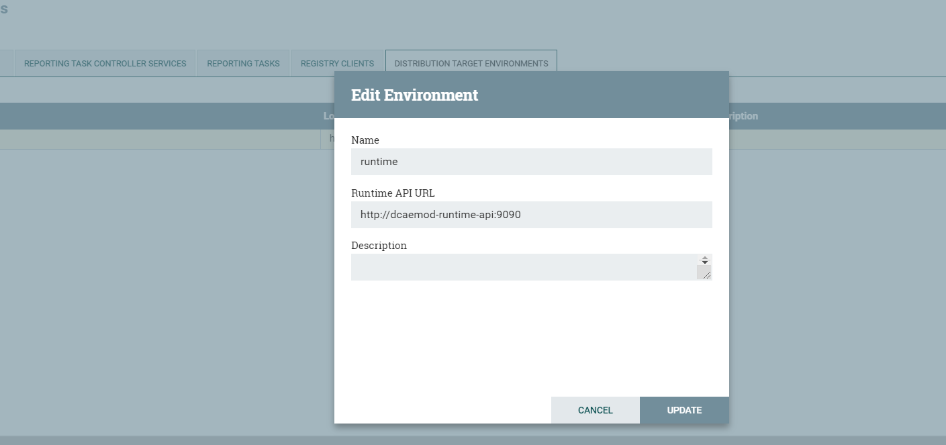
DCAE Design Flow
1
Configure Nifi Registry url
Next check Nifi settings by selecting the Hamburger button in the Nifi UI. It should lead you to the Nifi Settings screen
Add a registry client. The Registry client url will be http://dcaemod-nifi-registry:18080
2
Add distribution target which will be the runtime api url
Set the distribution target in the controller settings

Slide 19
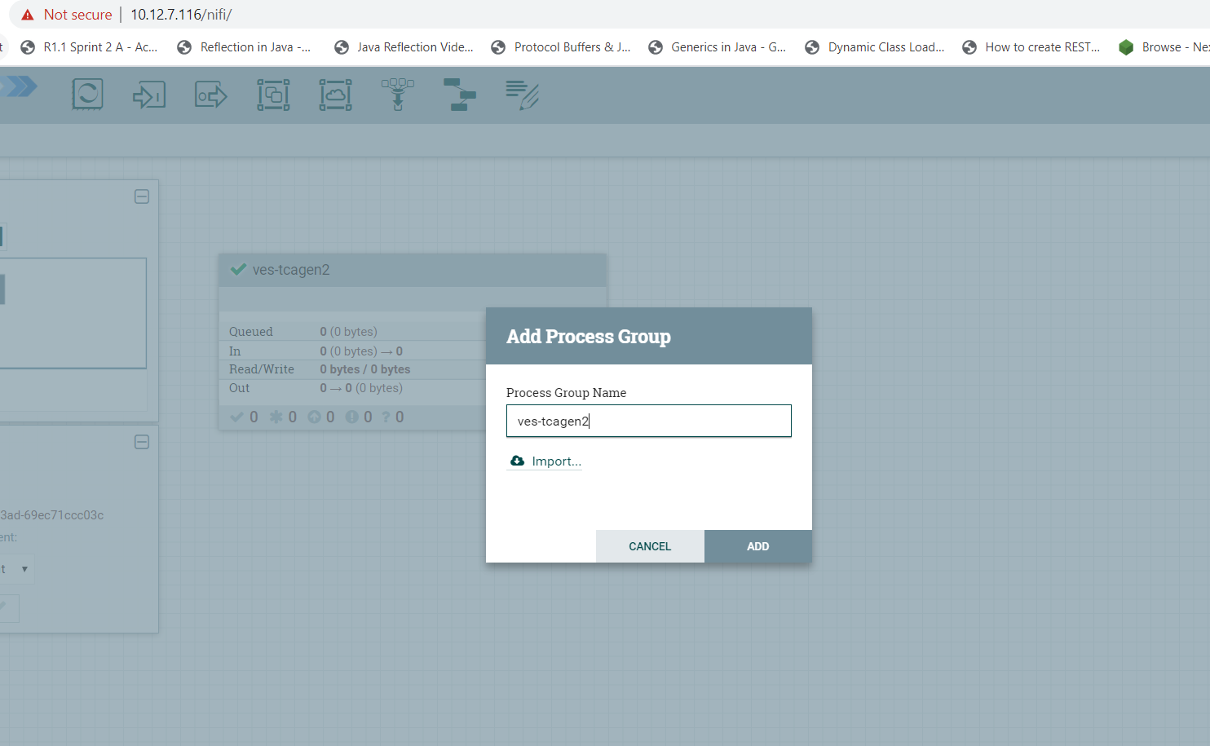
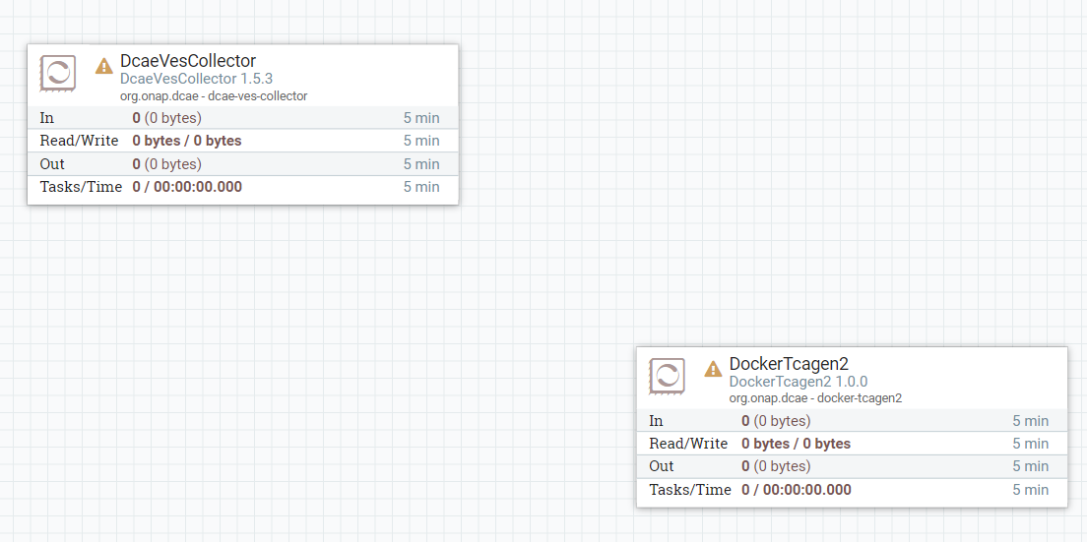
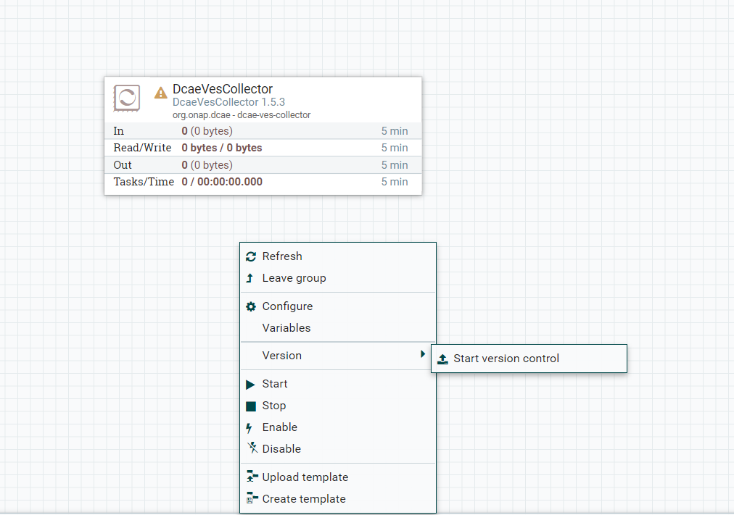
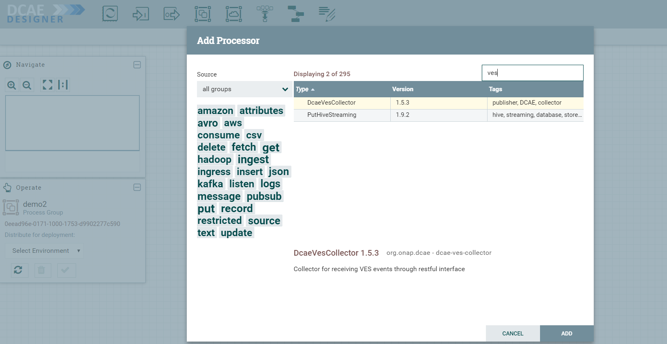
DCAE Design Flow Cont..
3
5
To start creating flows, we need to create a process group first. The name of the process group will be the name of the flow. Drag and Drop on the canvas, the ‘Processor Group’ icon from the DCAE Designer bar on the top.
Add more processors/components….
6
4
Version Control, save. We can do it anytime in flow creation.
Add Processor. Processors are DCAE Micro services.

Slide 20
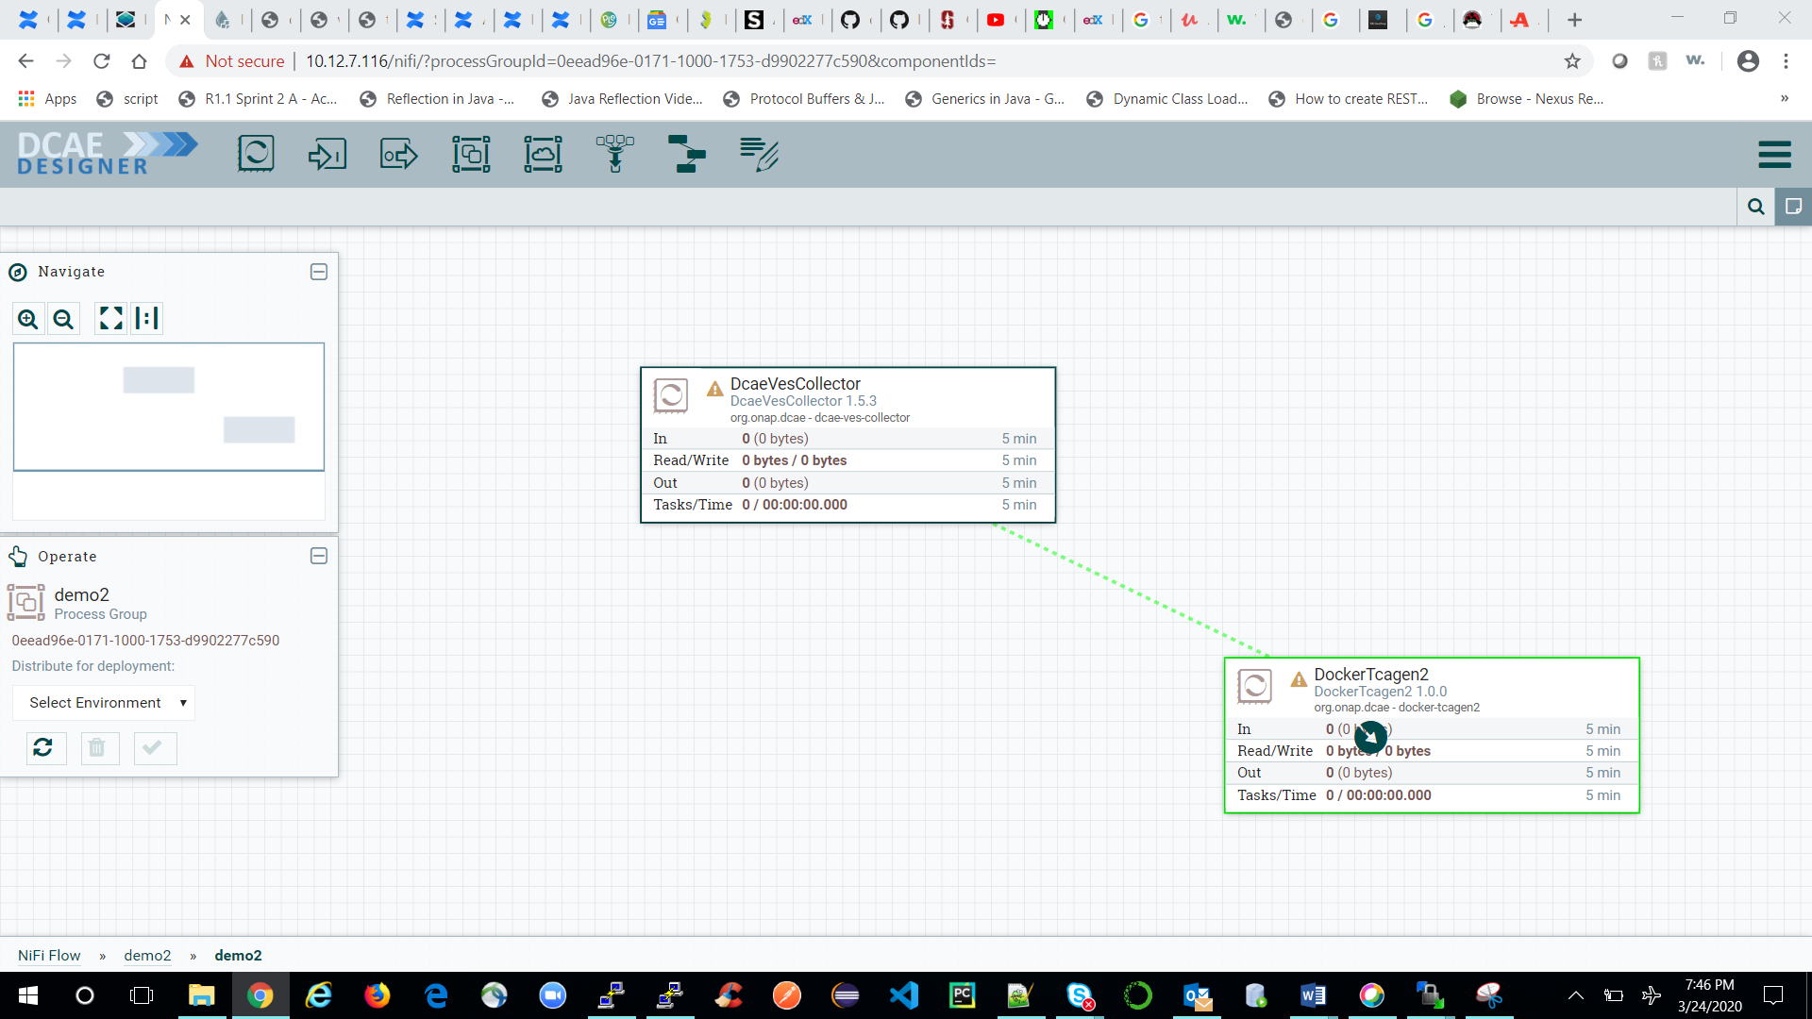
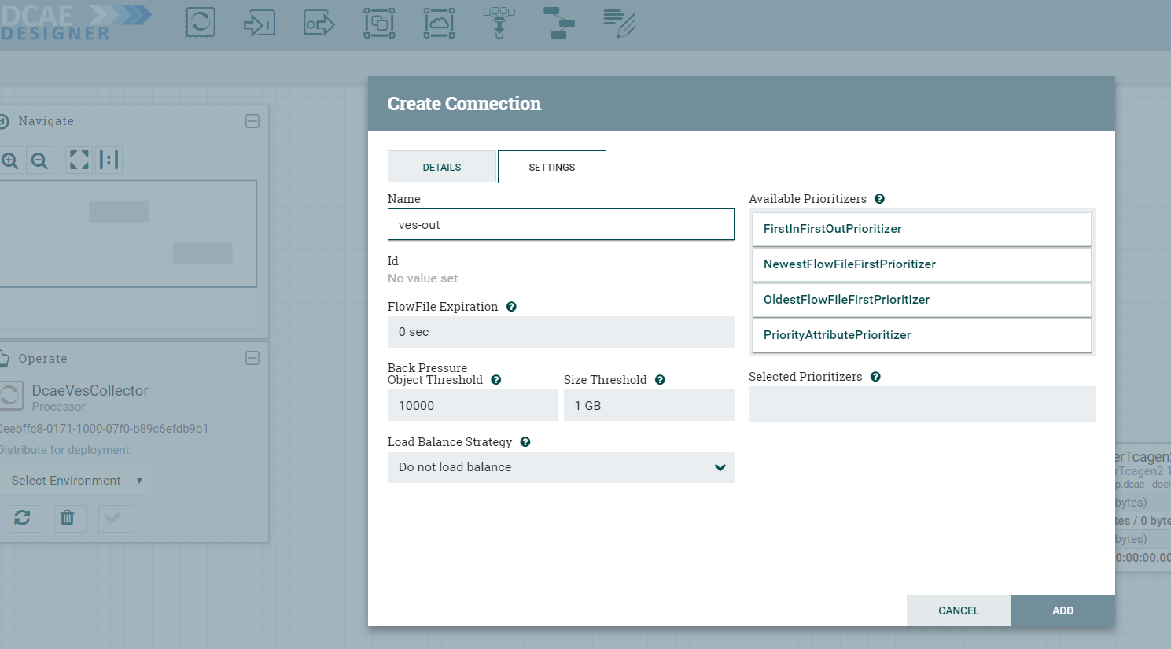
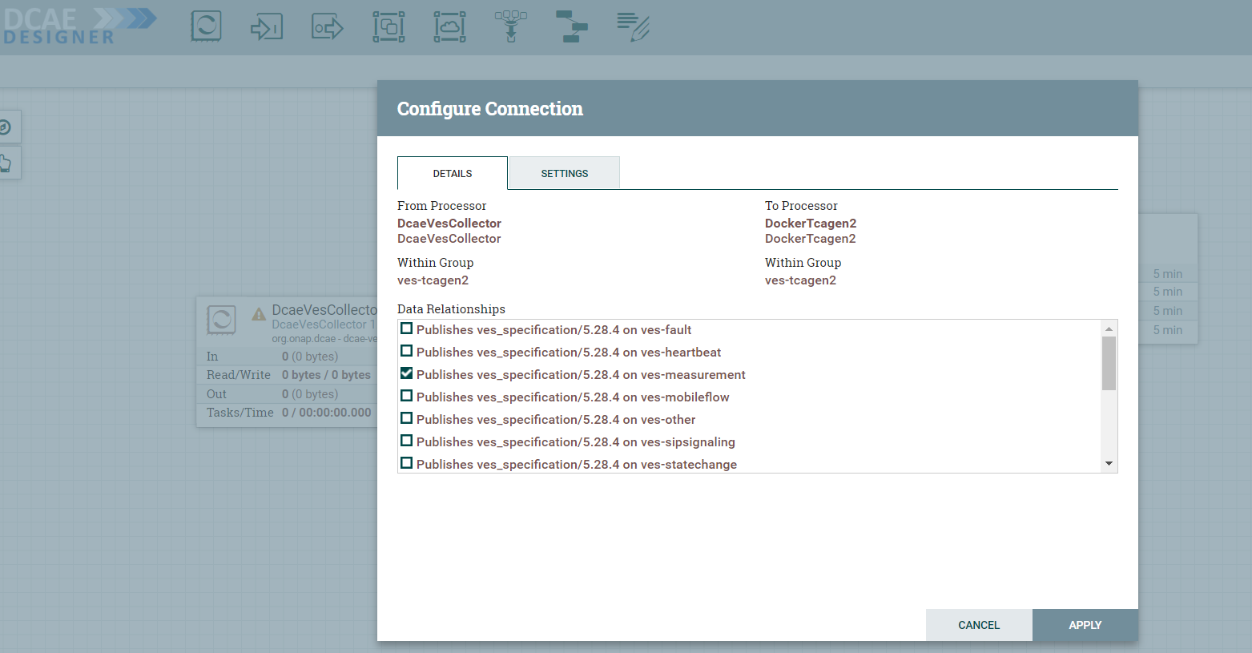
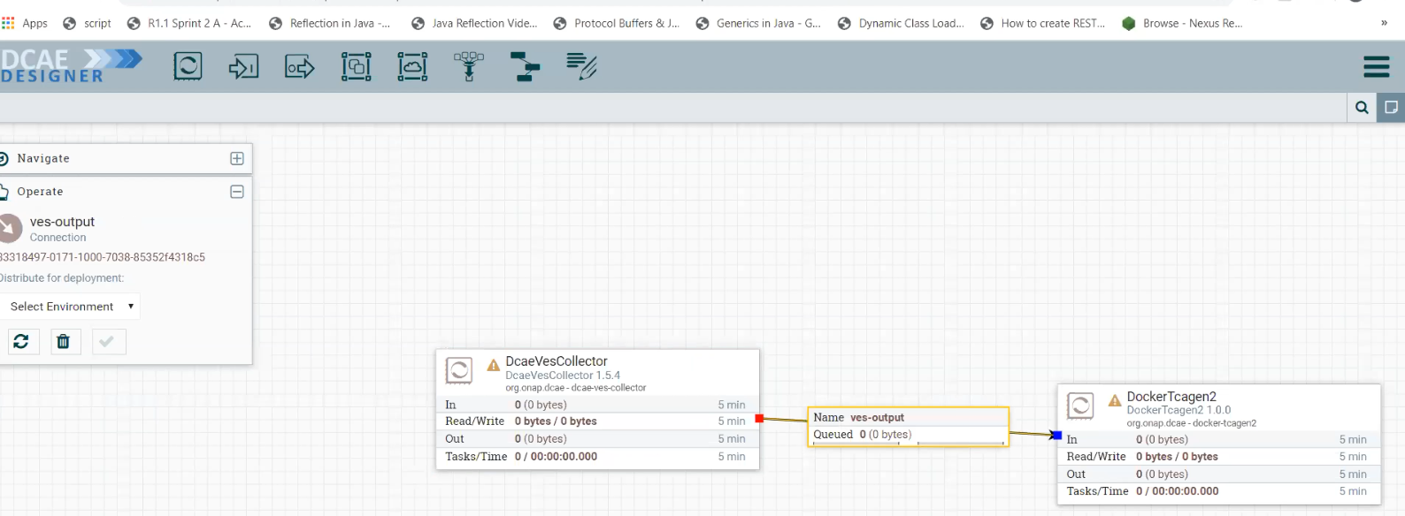
DCAE Design Flow Cont..
7
9
Connect them by dragging connection arrow from center of the processor.
Name and save it. You can change some parameter here.
8
Select appropriate data format.
10
Finally looks like this. Save the flow

Slide 21
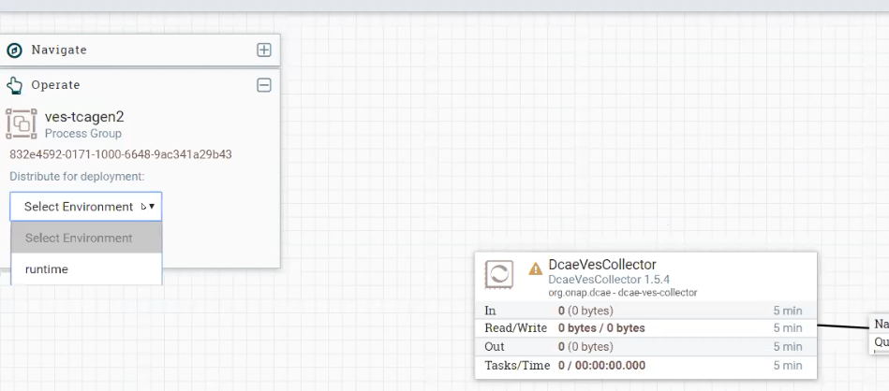
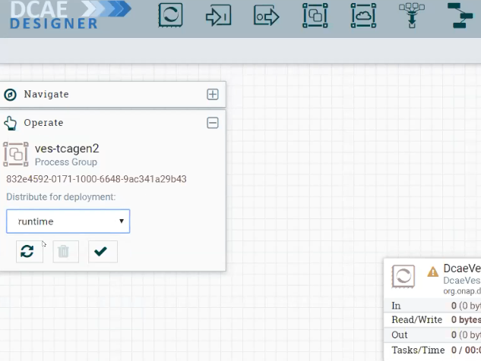
DCAE Distribution Flow
1
Select distribution target environment
2
Click on submit.
Now it goes to distribution target env i.e. entire design packaged and goes to runtime api for further generates blueprints.

Slide 22
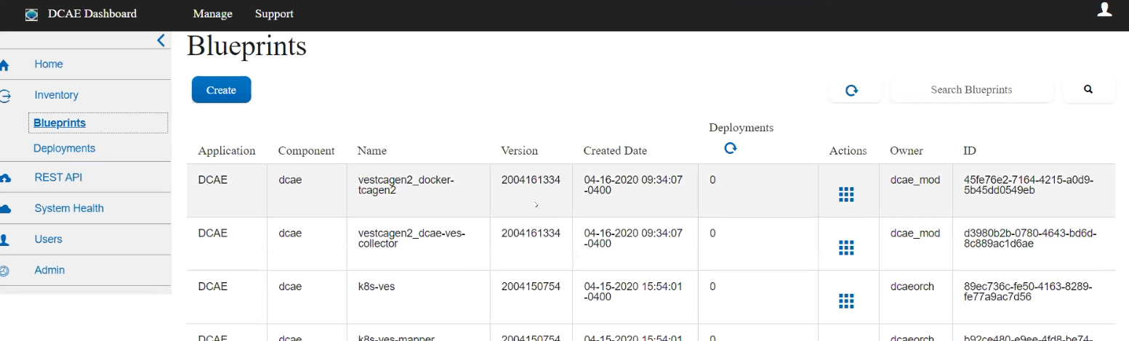
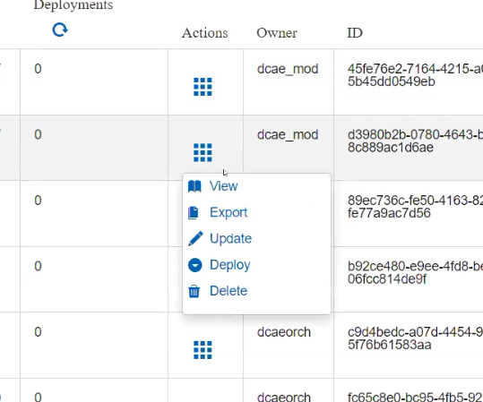
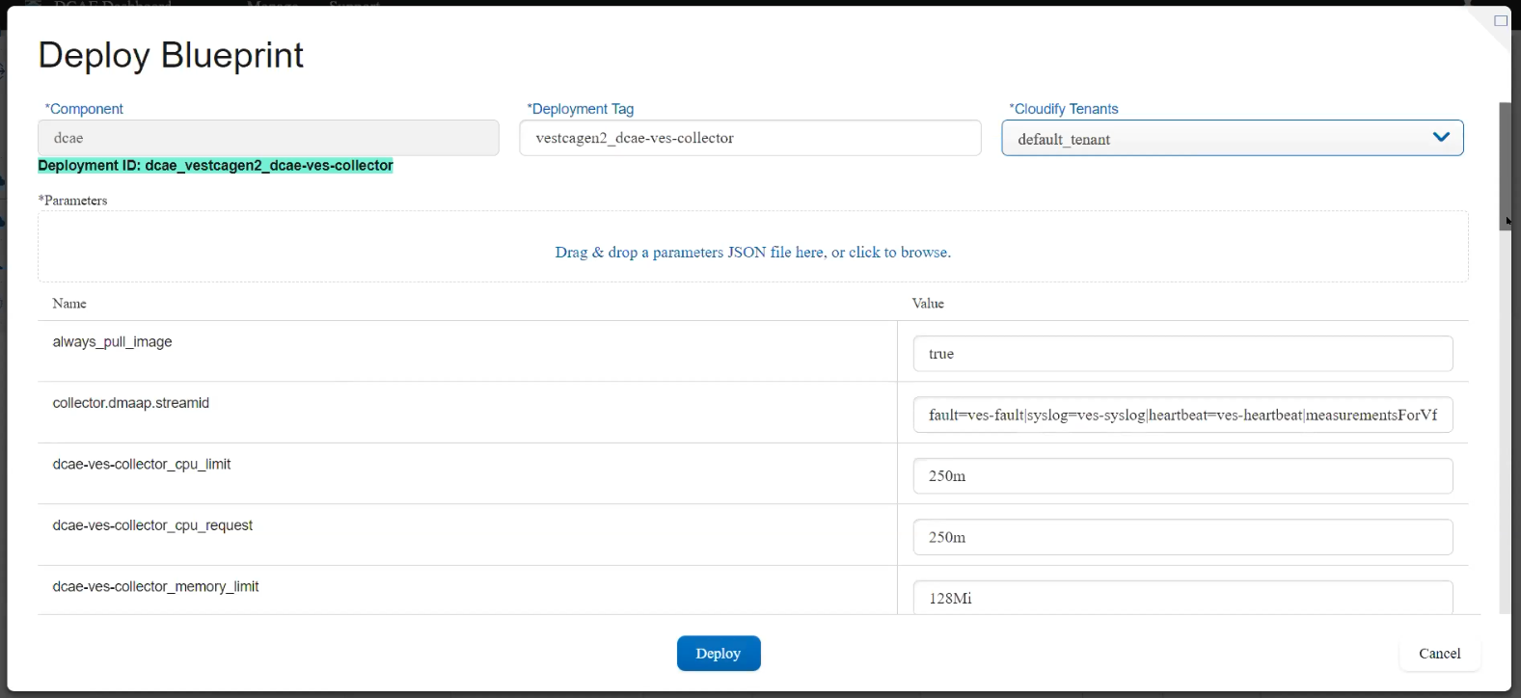
DCAE Service Deployment (Using DCAE dashboard)
1
Now blueprints appeared on dashboard.
3
2
Now blueprints appeared on dashboard. Click on actions - > deploy.
Select cloudify tenant,
If need any input param can upload json and then click on deploy.

Slide 23
DCAE RUNTIME

Slide 24
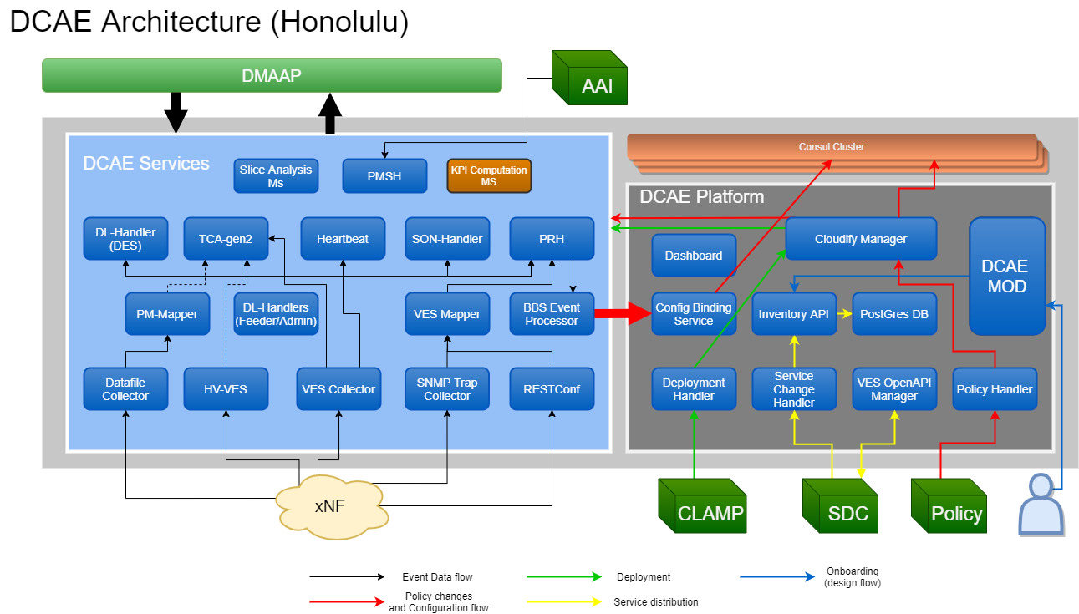
DCAE Runtime Architecture
DCAE runtime architecture comprises of DCAE Platform and DCAE Service components.
DCAE Platform:
DCAE Platform supports the functions to deploy, host and perform LCM applications of Service components.
DCAE platform helps to delpoy the Service component with appropriate configuration to appropriate location.
DCAE Platform also provisions DMaaP topics.
DCAE Service:
DCAE Service components are the functional entities that realize the collection and analytics needs of ONAP control loops. They include the collectors for various data collection needs, event processors for data standardization, analytics that assess collected data, and various auxiliary microservices that assist data collection and analytics
DCAE Run time architecture.
Note: “DCAE Mod” is not part of DCAE platform but not sure why its shown inside platform. Need to confirm.

Slide 25
DCAE Components
Consul: Distributed service discovery service and KV store.
Cloudify Manager:TOSCA model executor. Materializes TOSCA models of control loop, or Blueprints, into properly configured and managed virtual DCAE functional components
Event Processor: Data standardization. Data can be consumed by Analytics or policy etc.
Postgres Database: DCAE’s TOSCA model store.
Analytics: Assess the data.
DCAE Inventory-API: API for DCAE’s TOSCA model store.
Collectors: Collects various data from various xNFs.
Policy Handler: Handler for fetching policy updates from Policy engine; and updating the configuration policies of KV entries in Consul cluster KV store for DCAE components.
Configuration Binding Service: Agent for service component configuration fetching; providing configuration parameter resolution. All configuration (identified in component spec - parameters) itself are stored under CONSUL when blueprint gets executed part of component deployment. Some configuration such as topics are dynamic and may not be known for component owner to include in the docker image. Hence an important requirement for all onboarding services is to invoke the configbindingservice api during docker init script process to fetch the required application config.
Deployment Handler: API for triggering control loop deployment based on control loop’s TOSCA model.
Service Change Handler: Handler for interfacing with SDC; receiving new TOSCA models; and storing them in DCAE’s own inventory.
VES OpenApi Manager: Optional validator of VES_EVENT type artifacts executed during Service distributions.

Slide 26
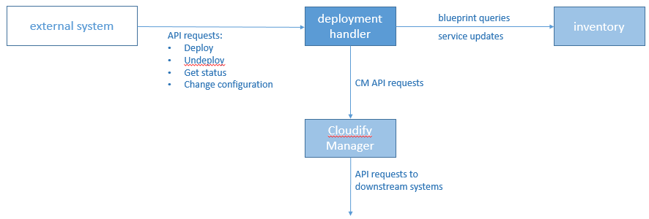
DCAE Platform : Deployment handler
DH's place in the DCAE orchestration system
The DCAE Deployment Handler (DH) is the interface to DCAE's orchestration system. The DH exposes an HTTP-based API that allows client systems to request the deployment of DCAE services based on service blueprints stored in the DCAE inventory, as well to check the status of deployments and to request undeployment of a previously-deployed service.

Slide 27
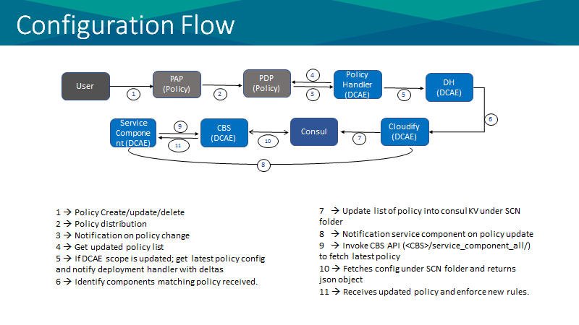
DCAE Platform : Policy handler
Policy Handler job is to handle configuration policy change or fetch latest policy from Policy framework and send to consul. Later it’ll be picked up by DCAE microservices.

Slide 28
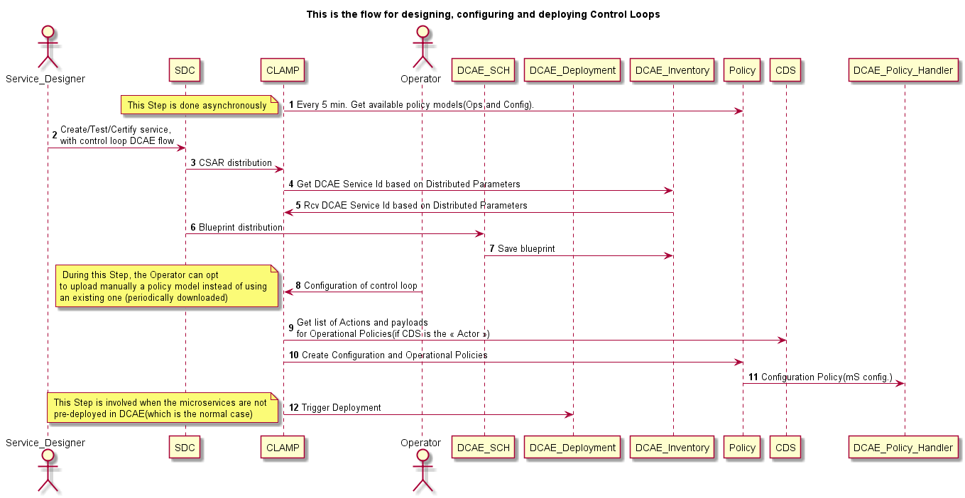
DCAE Platform : Service Change Handler
It faces towards SDC and receives service change notification. It saves the service to DCAE inventory.

Slide 29
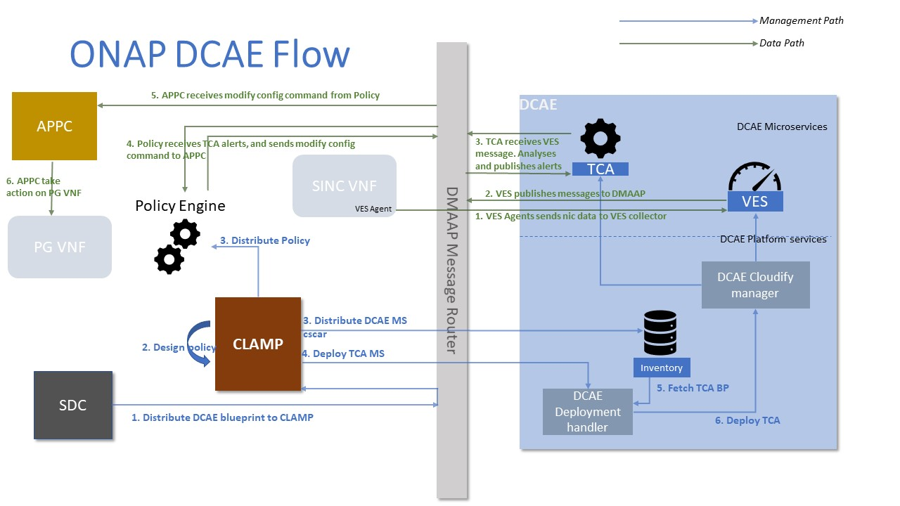
DCAE Deployment and Runtime(Close Loop) Flow
You can deploy DCAE via DCAE dashboard.
This figure depicts one sample deployment of VES mapper and TCA micro service and runtime action.

Slide 30
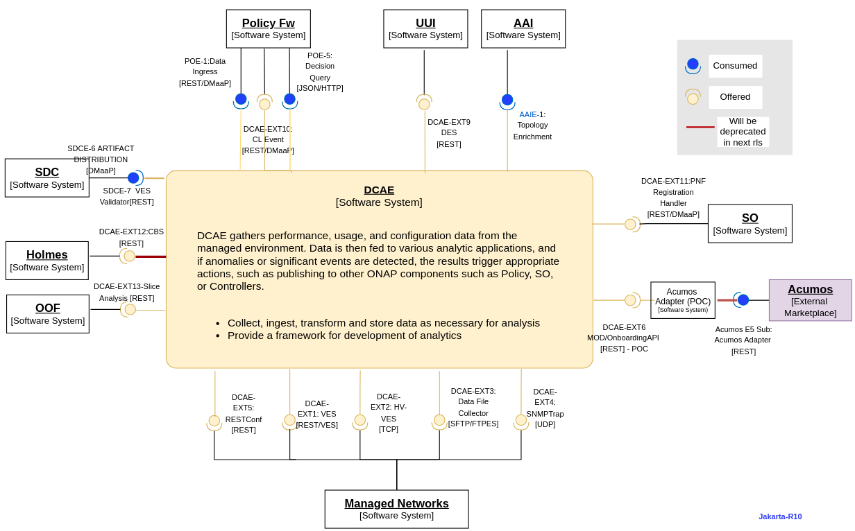
DCAE APIs
High Level Component Definition and Architectural Relationships

Slide 31
DCAE Provided API
Interface Name | Interface Definition | Interface Capabilities | Protocol | Status | API Spec (Swagger)
DCAE-EXT1 | VES Collector | An interface to share FM/PM data for VNF FCAPS from the VNFs via the EMS Driver to VES Collector | REST | Available | VES-Collector
DCAE-EXT2 | HV-VES Collector | Interface to support GPB over TCP for highvolume VES Events | Proto/TCP | Available | HV-VES (High Volume VES)
DCAE-EXT3 | DataFileCollector | Supports bulk/batch datafile collection from xNF | http/sftp/ftpes | Available | NA
DCAE-EXT4 | SNMPTrap | Supports SNMP traps collection from SNMP agents deployed in the network | UDP | Available | NA
DCAE-EXT5 | RESTConf | Subscribes to external controllers and retrieves data | restconf | Available | RESTConf
DCAE-EXT6 | OnboardingAPI (MOD) | Used for onboarding MS component spec file and data-format into Design catalog | REST | Available (POC) | Onboarding HTTP API (MOD)
DCAE-EXT9 | Data Extraction Service (DES) | Provides basic computation and data retrieval/access from datastorage maintained by DL handlers (Feeder) | REST | Available (Guilin) | des-swagger.json
DCAE-EXT10 | DCAE Openloop/CL Event | Open loop and Control Loop event trigger from DCAE analytics/correlation MS into DMAAP | REST | Available | CL Event Structure
DCAE-EXT11 | PNF Registration Handler | PNF Registration event published through DMAAP | REST | Available | PRH (PNF Registration Handler)
DCAE-EXT12 | ConfigBindingService (CBS) | The CBS provides API for all DCAE deployment mS to retrieve configuration from Consul. | REST | Available | CBS API
DCAE-EXT13 | SliceAnalysis MS | API to provide details of remaining capacity available for queried slice instance (NSI/NSSI) NSI/NSSI Selection based on resource occupancy levels | REST | Available | https://wiki.onap.org/download/attachments/117740396/slice-analysis-swagger.yaml?version=1&modificationDate=1640159785000&api=v2
DCAE-EXT14 | PM Subscription Handler Service | Adds API support for Subscription/Filters/Measurement group management | REST | Available | https://gerrit.onap.org/r/c/dcaegen2/+/126725
Notes:
https://wiki.onap.org/display/DW/ARC+DCAE+Component+Description+-+Jakarta-R10

Slide 32
DCAE Consumed API
Interface Name | Interface Definition | Interface Capabilities | Protocol | Status | API Spec (Swagger)
POE-5 | PDP - DCAE Policy Sidecar | Fetched policies for DCAE MS from the Policy Framework via PDP query | REST | Available | POE-5 (Policy Decision API)
AAIE-1 | Topology Enrichment | Enrichment query by Correlation/analytics MS | REST | Available | AAI REST API Documentation on readthedocs.io
Acumos-E5 Subscription | Acumos - AA (MOD) | Acumos Adapter - Retrieves models from Acumos using E5 interface and onboard them into DCAE (MOD) using OnboardingAPI and make it available in Catalog | REST | Available (POC)
SDCE-7 | Artifact Distribution | DCAE-VESOpenAPI manager uses notification to retrieve VES schema uploaded and perform validation | REST | Available | https://docs.onap.org/projects/onap-sdc/en/latest/offeredapis.html

Slide 33
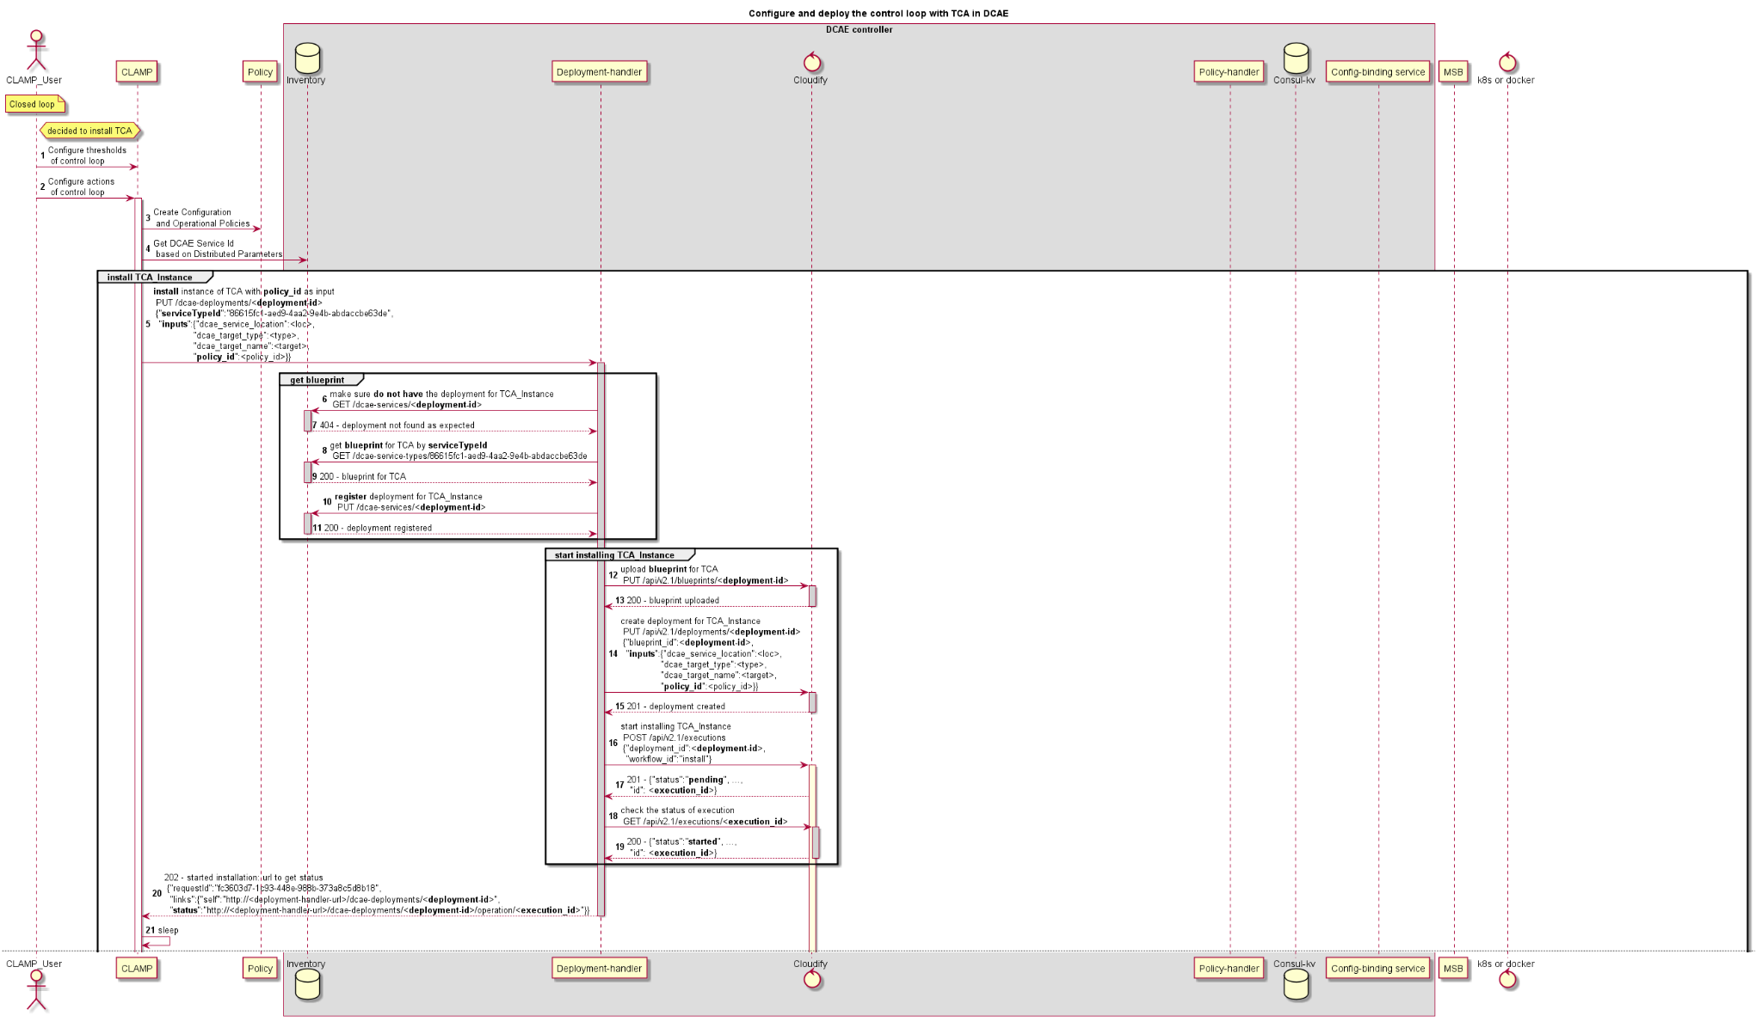
Installation of a DCAE Microservice via CLAMP
Configure and starting the deployment of TCA through CLAMP and DCAE-Controller

Slide 34
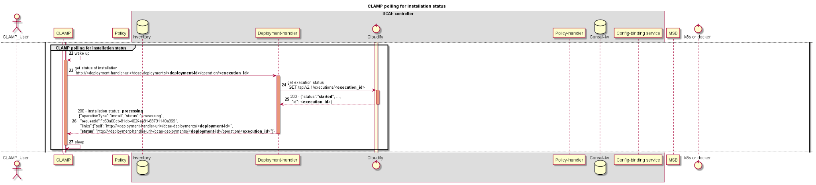
Installation of a DCAE Microservice via CLAMP
Configure and starting the deployment of TCA through CLAMP and DCAE-Controller

Slide 35
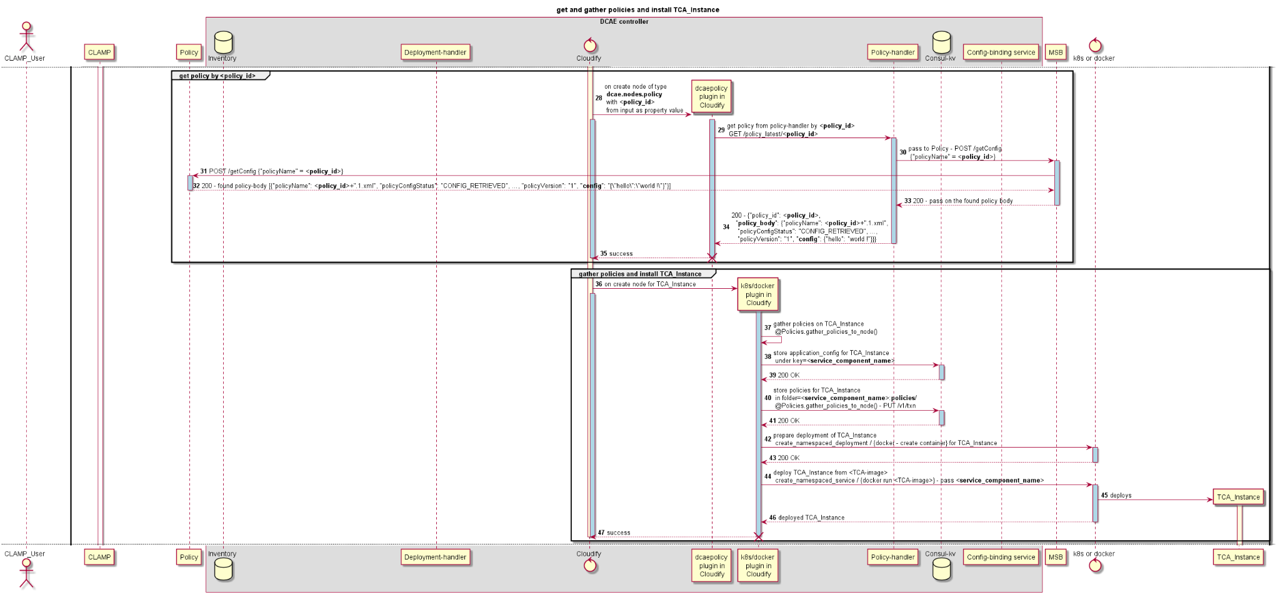
Installation of a DCAE Microservice via CLAMP
Get and gather policies and install TCA instance

Slide 36
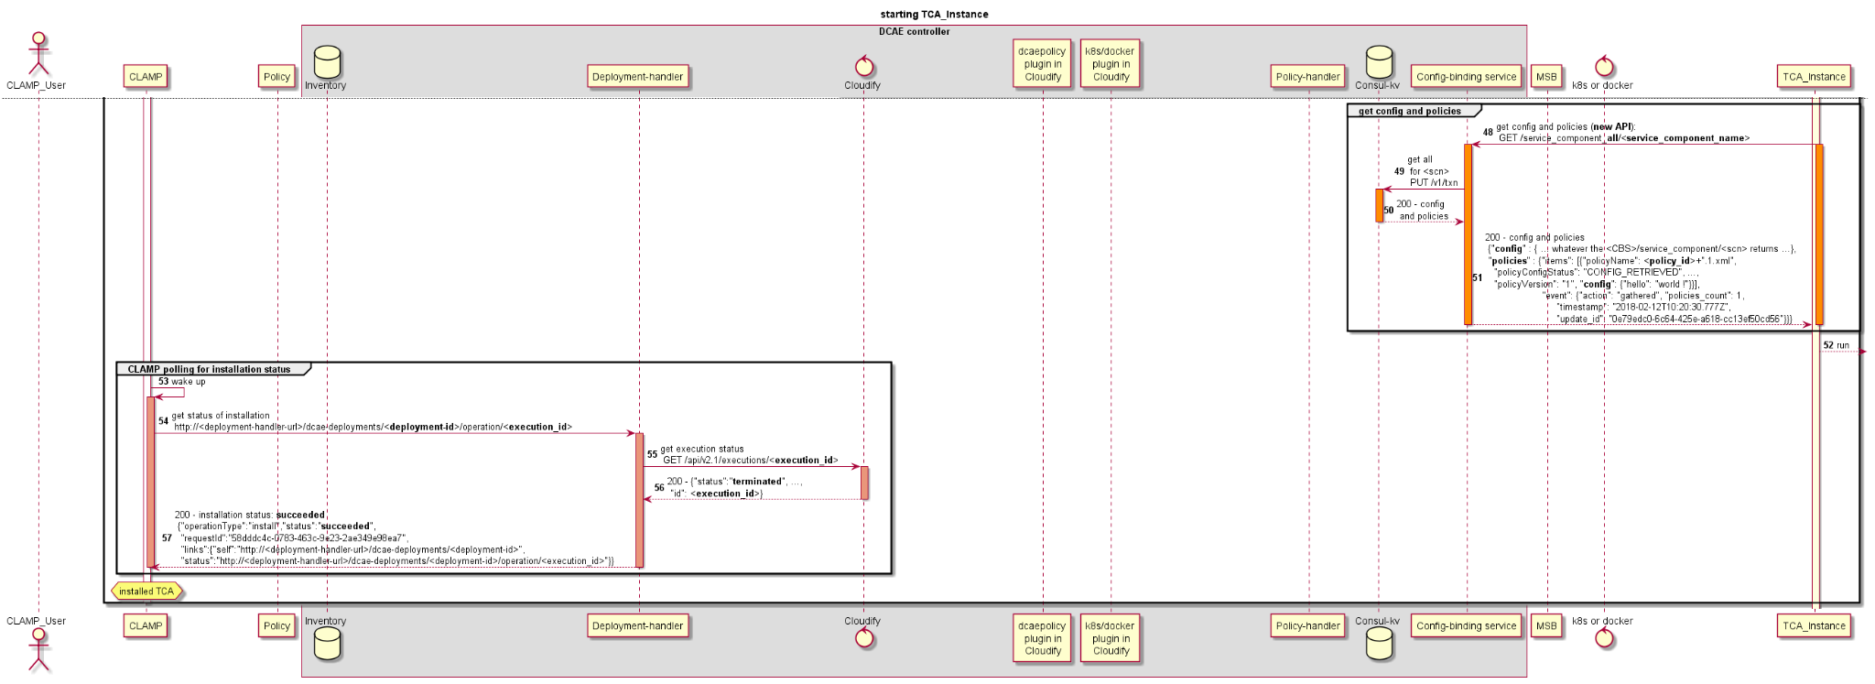
Installation of a DCAE Microservice via CLAMP
Starting TCA instance and end of installation

Slide 37
Configuration Policy for DCAE micro service(Another view of last page)
Some Microservice in DCAE need policy to update its configuration dynamically.
The service component should include a script within the container and specify that in component spec
Component spec
"auxilary": {
"policy": {
"trigger_type": "docker",
"script_path": "/opt/app/reconfigure.sh"
}
}
This script must have necessary logic to invoke CBS API and cascade the information for application processing.
The corresponding blueprint should include following
docker_config:
policy:
script_path: /opt/app/mean/reconfigure.sh
trigger_type: docker
This figure depicts how Configuration policy updated to a DCAE microservice.

Slide 38
DCAE Micro services

Slide 39
DCAE Microservices
DCAE has following microservices.
Collectors
DataFile Collector(DFC) : Collects Files from xNF.
RestConf Collector: It subscribes to external controllers and receives event data over rest API.
SNMP Trap Collector: It receives SNMP traps and publishes them to a message router.
High Volume VNF Event Streaming (HV-VES) Collector : Process high-volumes of data generated frequently by a large number of NFs and use stream connections.
VNF Event Streaming (VES) Collector: It is RESTful collector for processing JSON messages into DCAE.
Event Processor
BBS-EventProcessor :Used to handle BBS use case. Receive PNF registration and CPE authentication event, and modify them as per use case.
DataLake-Handler MS: It systematically persist the events from DMaaP into supported Big Data storage systems.
VES-Mapper: VES-Mapper provides a generic adapter to convert different formats of event and telemetry data into VES structure
3GPP PM Mapper Service: It processes 3GPP PM XML files to produce perf3gpp VES PM Events.
PNF Registration Handler (PRH): It is used during Physical Network Function (PNF) Plug-n-Play procedure to process the PNF Registration event.
Holmes correlation analytics: Analyze alarm root cause based on drools engine, and trigger close loop actions. (From Jakarta Release it is part of DCAE)
Analytics
Heartbeat Microservice: It is to receive the periodic heartbeat from the configured eventNames and report the loss of heartbeat
Kpi Computation MS: Do KPI computation based on KPI formula and the formula can be configured dynamically. Publish KPI results on DMaaP.
PM Subscription Handler: It allows for the definition and activation of PM subscriptions on one or more network function (NF) instances.
Slice Analysis MS: Analyzing the FM/PM data (reported from the xNFs) and KPI data (computed from PM data) related to various slice instances and trigger appropriate Control Loop actions
SON-Handler MS: It is implementing the pre-processing and coordination actions of various RAN SON use cases.
Threshold Crossing Analytics (TCA-gen2): When measurement events are received TCA-gen2 performs a comparison of an incoming performance metric(s) against both a high and low threshold defined and generates CL events when threshold are exceeded.

Slide 40
DCAE Microservices Usecase
For ONAP DCAE participates in the following use cases.
Use Case | DCAE Micro Services
vDNS | VES collector, TCA analytics
vFW | VES collector, TCA analytics
vCPE | VES collector, TCA analytics
vVoLTE | VES collector, Holmes analytics
CCVPN | RestConf Collector, Holmes
BBS | VES Collector, PRH, BBS-Event Processor, VES-Mapper, RESTConf Collector
5G Bulk PM | DataFile Collector, PM-Mapper, HV-VES
5G OOF SON | VES collector, SON-Handler
5G E2E Network Slicing: | VES collector, Slice Analysis, DES, PM-Mapper, DFC, Datalake feeder
https://docs.onap.org/projects/onap-dcaegen2/en/latest/sections/architecture.html

Slide 41
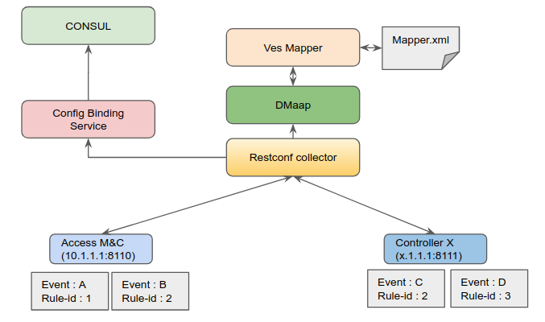
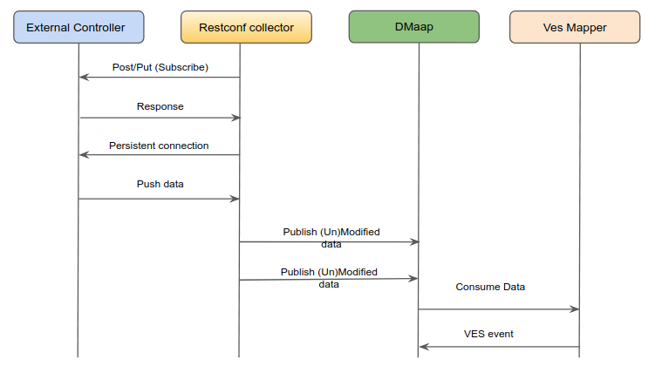
Collectors: Restconf collector
Restconf collector is a microservice in ONAP DCAE. It subscribes to external controllers and receives event data. After receiving event data it may modify it as per usecase’s requirement and produce a DMaaP event. This DMaap event usually consumed by VES mapper. Restconf Collector can subscribe multiple events from multiple controllers.
RestconfCollector interaction with DCAE components.
RestconfCollector interaction with an external controller.

Slide 42
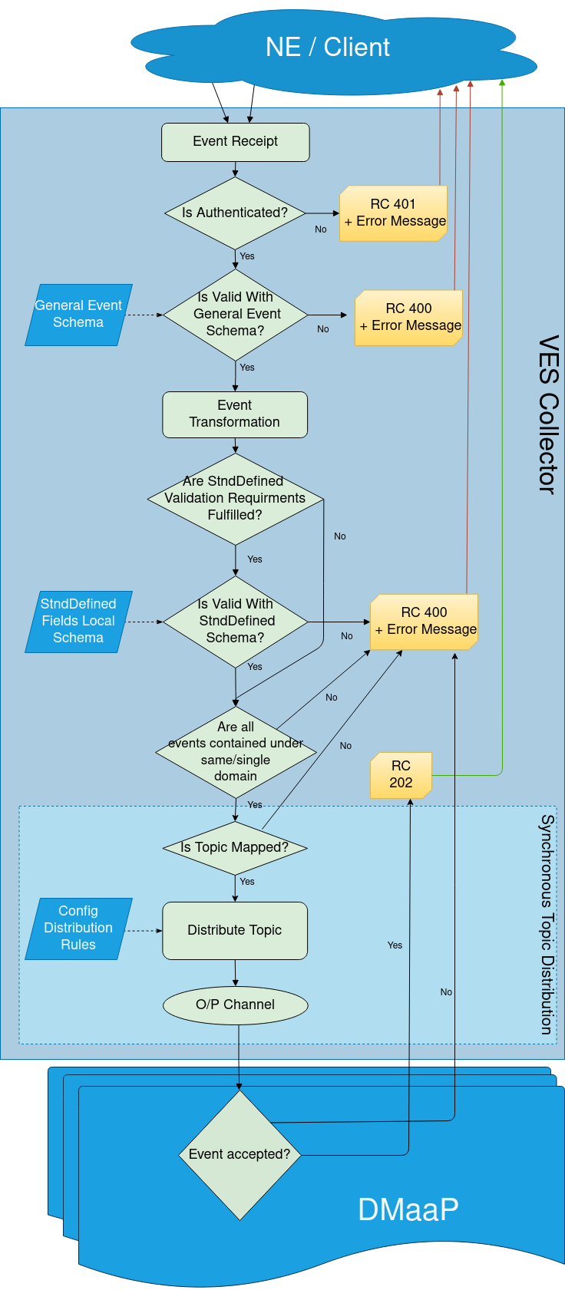
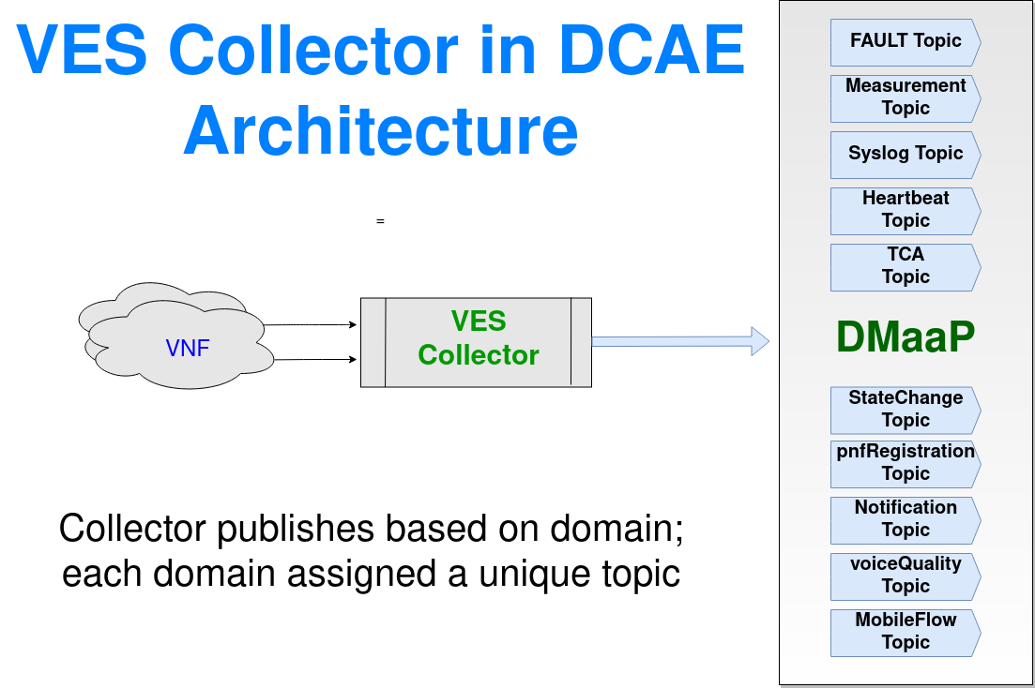
Collectors: VES collector
Virtual Event Streaming (VES) Collector (formerly known as Standard Event Collector/Common Event Collector) is RESTful collector for processing JSON messages into DCAE. The collector supports individual events or eventbatch posted to collector end-point(s) and post them to interface/bus for other application to subscribe. The collector verifies the source (when authentication is enabled) and validates the events against VES schema before distributing to DMAAP MR topics for downstream system to subscribe. The VESCollector also supports configurable event transformation function and event distribution to DMAAP MR topics.
VES Version | API version | Schema Definition
VES 1.2 | eventListener/v1 | CommonEventFormat_Vendors_v25.json
VES 4.1 | eventListener/v4 | CommonEventFormat_27.2.json
VES 5.4 | eventListener/v5 | CommonEventFormat_28.4.1.json
VES 7.2.1 | eventListener/v7 | CommonEventFormat_30.2.1_ONAP.json
VES Collector is configured to support above VES Version; the corresponding API uses VES schema definition for event validation.
@TODO: Add use case example.
VES Collector in DCAE
VES Processing Flow

Slide 43
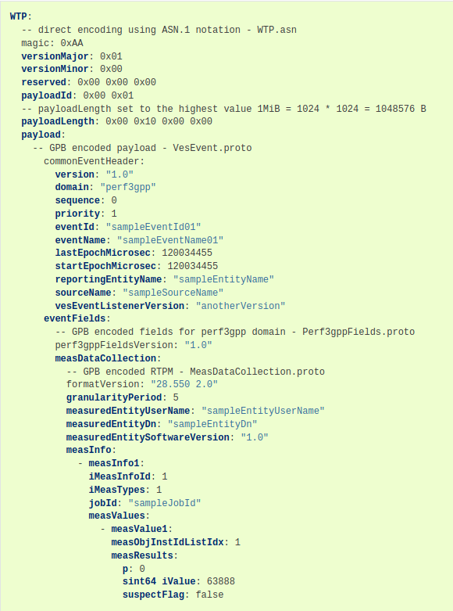
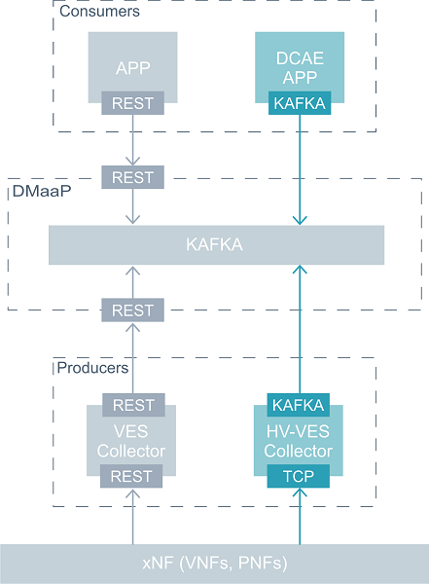
Collectors: High Volume VNF Event Streaming (HV-VES)
HV-VES collector has been proposed, based on a need to process high-volumes of data generated frequently by a large number of NFs nd publish it to kafka.Input messages come from TCP interface and Wire Transfer Protocol. Each frame includes Google Protocol Buffers (GPB) encoded payload. Based on information provided in CommonEventHeader, domain messages are validated and published to specific Kafka topic in DMaaP.
HV-VES Collector is a high-volume variant of the existing VES (JSON) collector, and not a completely new collector. HV-VES follows the VES-JSON schema as much as possible.
HV-VES uses a Google Protocol Buffers (GPB, proto files) representation of the VES Common Header.
The proto files use most encoding-effective types defined by GPB to cover Common Header fields.
HV-VES makes routing decisions based on the content of the domain field or stndDefinedNamespace field in case of stndDefined events.
HV-VES allows to embed Payload of different types (by default perf3gpp and stndDefined domains are included).
HV-VES interaction with DCAE components.
HV-VES Example Event.

Slide 44
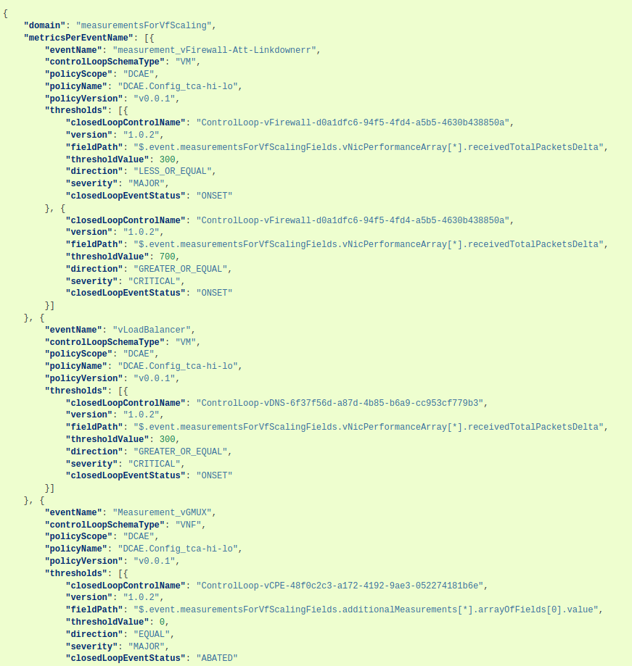
Analytics: Threshold Crossing Analytics (TCA-gen2)
TCA-gen2 subscribed measurement events from DMAAP in VES structure, once events are recieved TCA-gen2 performs a comparison of an incoming performance metric(s) against both a high and low threshold defined and generates CL events when threshold are exceeded. When the original threshold defined are cleared, TCA-Gen2 will generate an ABATEMENT event to notify the downstream system on original problem being cleared.
@TODO: Use case example.
Sample TCA-gen2 configuration

Slide 45
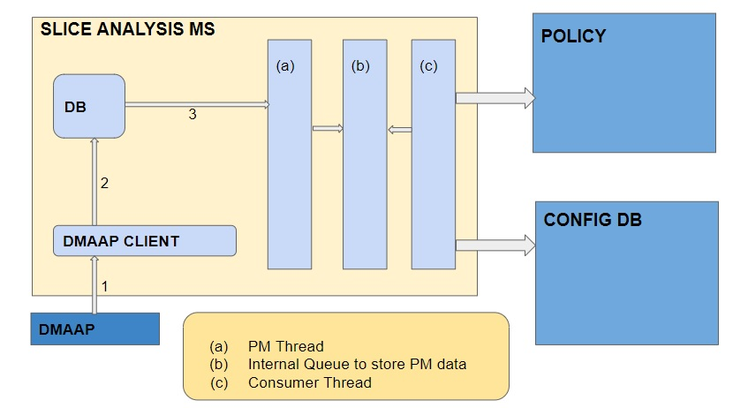
Analytics: Slice Analysis
Slice Analysis MS is introduced in ONAP for: (a) Analyzing the FM/PM data (reported from the xNFs) and KPI data (computed from PM data) related to various slice instances (NSIs), slice sub-net instances (NSSIs) and services catered to by the slices (S-NSSAIs). (b) Determining and triggering appropriate Control Loop actions based on the analysis above (c) Receiving recommendations for closed loop actions from ML or Analytics engines, performing validity checks, etc. to determine if the actions can be carried out, and then triggering the appropriate Control Loop
In Guilin, this MS: - Performs simple Closed Loop control action for the RAN slice sub-net instances based on simple analysis of a set of RAN PM data - Initiates simple control loop actions in the RAN based on recommendation from an ML engine for RAN slice sub-net instance re-configuration
@TODO: Add input message, API call example.
slice Analysis component Architecture

Slide 46
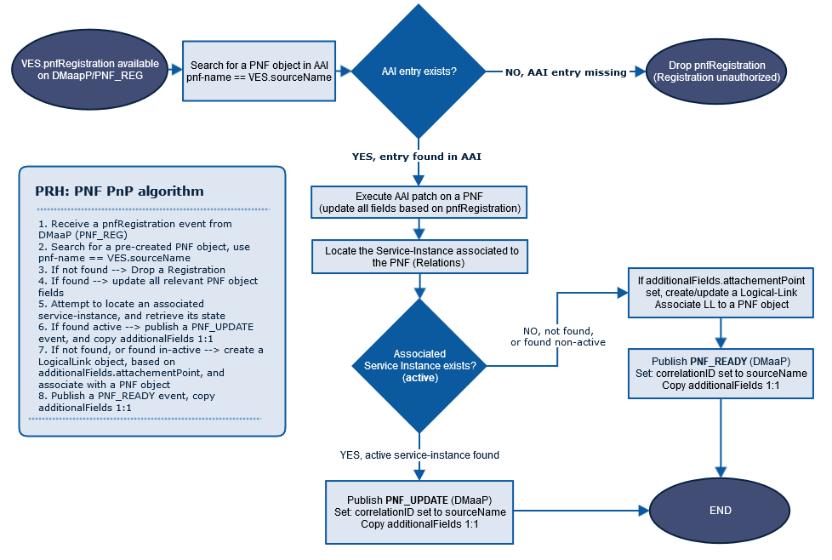
Event Processor: PNF Registration Handler (PRH)
PNF Registration Handler is a micro-service in DCAE. It is used during Physical Network Function (PNF) Plug-n-Play procedure to process the PNF Registration event. It used to register PNF when it comes online.
@TODO: Add input message, Use case example.
PRH PRocessing Flow

Slide 47
Close Loop components

Slide 48

CLAMP
High Level Component Definition and Architectural Relationships

Slide 49
How To add a DCAE Microservice
https://wiki.onap.org/pages/viewpage.action?pageId=36963506

Slide 50
How to deploy DCAE Runtime and DCAE Mod
https://docs.onap.org/projects/onap-dcaegen2/en/latest/sections/installation.html

Slide 51

Technical Insight: Dmaap
DMaaP is component that provides data movement services that transports and processes data from any source to any target. It provides the capability to:
Support the transfer of messages between ONAP components, as well as to other components
Support the transfer of data between ONAP components as well as to other components.
Data Filtering capabilities
Data Compression capabilities
Data routing (file based transport)
Message routing (event based transport)
Batch and event based processing
Message Router (MR) - Message Router is a reliable, high-volume pub/sub messaging service with a RESTful HTTP API. It is intended to be deployed by Platform Service providers so that it is available to Platform clients as a web service. The service is initially built over Apache Kafka. Normally carry json/text payload.
Data Router (DR) - The Data Routing System project is intended to provide a common framework by which data producers can make data available to data consumers and a way for potential consumers to find feeds with the data they require. The interface to DR is exposed as a RESTful web service known as the DR Publishing and Delivery API. Use for large files.
https://wiki.onap.org/pages/viewpage.action?pageId=3247130

Slide 52
END

Slide 53
ONAP Istanbul Architecture

Slide 54
Nifi Terminology (Required when do code level)
FlowFile | A FlowFile represents each object moving through the system and for each one, NiFi keeps track of a map of key/value pair attribute strings and its associated content of zero or more bytes.
Connection | Connections provide the actual linkage between processors.
Processor | a processor is doing some combination of data routing, transformation, or mediation between systems. Processors have access to attributes of a given FlowFile and its content stream.
Process Group | A Process Group is a specific set of processes and their connections, which can receive data via input ports and send data out via output ports. In this manner, process groups allow creation of entirely new components simply by composition of other components. In Layman term it identifies a flow in DCAE MOD.
Controller | The Flow Controller maintains the knowledge of how processes connect and manages the threads and allocations thereof which all processes use.

Slide 55
TODO
Add a slide for DMaap?
Add a slide for comp spec, data format and blueprint with example.??
Deployment point?//
With ONAP deployment, four DCAE services (HV VES collector, VES collector, PNF Registration Handler, and TCA (Gen2) analytics service) are bootstrapped via Helm charts.
Other DCAE Services are deployed on-demand, after ONAP/DCAE installation, through Cloudify Blueprints or helm-charts.
With DCAE Transformation to Helm in Istabul, all DCAE components are supported for both helm and Cloudify/Blueprint deployments.
- If helm then configuration passed as helm values.
- If by cloudify then configuration passed as blueprint files.
Istanbul will be final release where Cloudify blueprint for components/microservices will be supported. // Otherwise what it’ll be in jakarta?? Is it going to generate helm files for MS?
helm -n onap install dev-dcaegen2-services-ves-mapper oom/kubernetes/dcaegen2-services/components/dcae-ves-mapper -f values.yaml
Why should I install ms as on demand using commands? Should not it be via dcae mod.
1. How to onbaord a acumos ml
2. How to onboard a policy
3. How to onboard dcae ms

Slide 56
DCAE Onboarding Prerequisite
Defining the data formats if they don’t already exist.A component is a software application that performs a function. It doesn’t run independently; it depends upon other components. The upstream and downstream components must speak the same vocabulary or data format.
Defining the component specification. The component specification is a JSON artifact that fully specifies the component, it’s interfaces, and configuration. The component specification is used by:
Blueprint Generator
MOD Platform
Policy (future)
Runtime platform
Validate the component spec schema against Component Spec json schema
Use blueprint-generator tool to generate Cloudify blueprint
Test the blueprint generated in DCAE Runtime Environment (using either Dashboard UI or Cloudify cli from bootstrap)
Using DCAE-MOD , publish the component and data formats into DCAE-MOD catalog. (This step is required if Microservice needs to be deployed part of flow/usecase)

Slide 57

Close loop Design After DCAE MOD (Another View)
https://docs.onap.org/projects/onap-clamp/en/latest/
https://wiki.onap.org/display/DW/CLAMP+Flows

